Slide 1
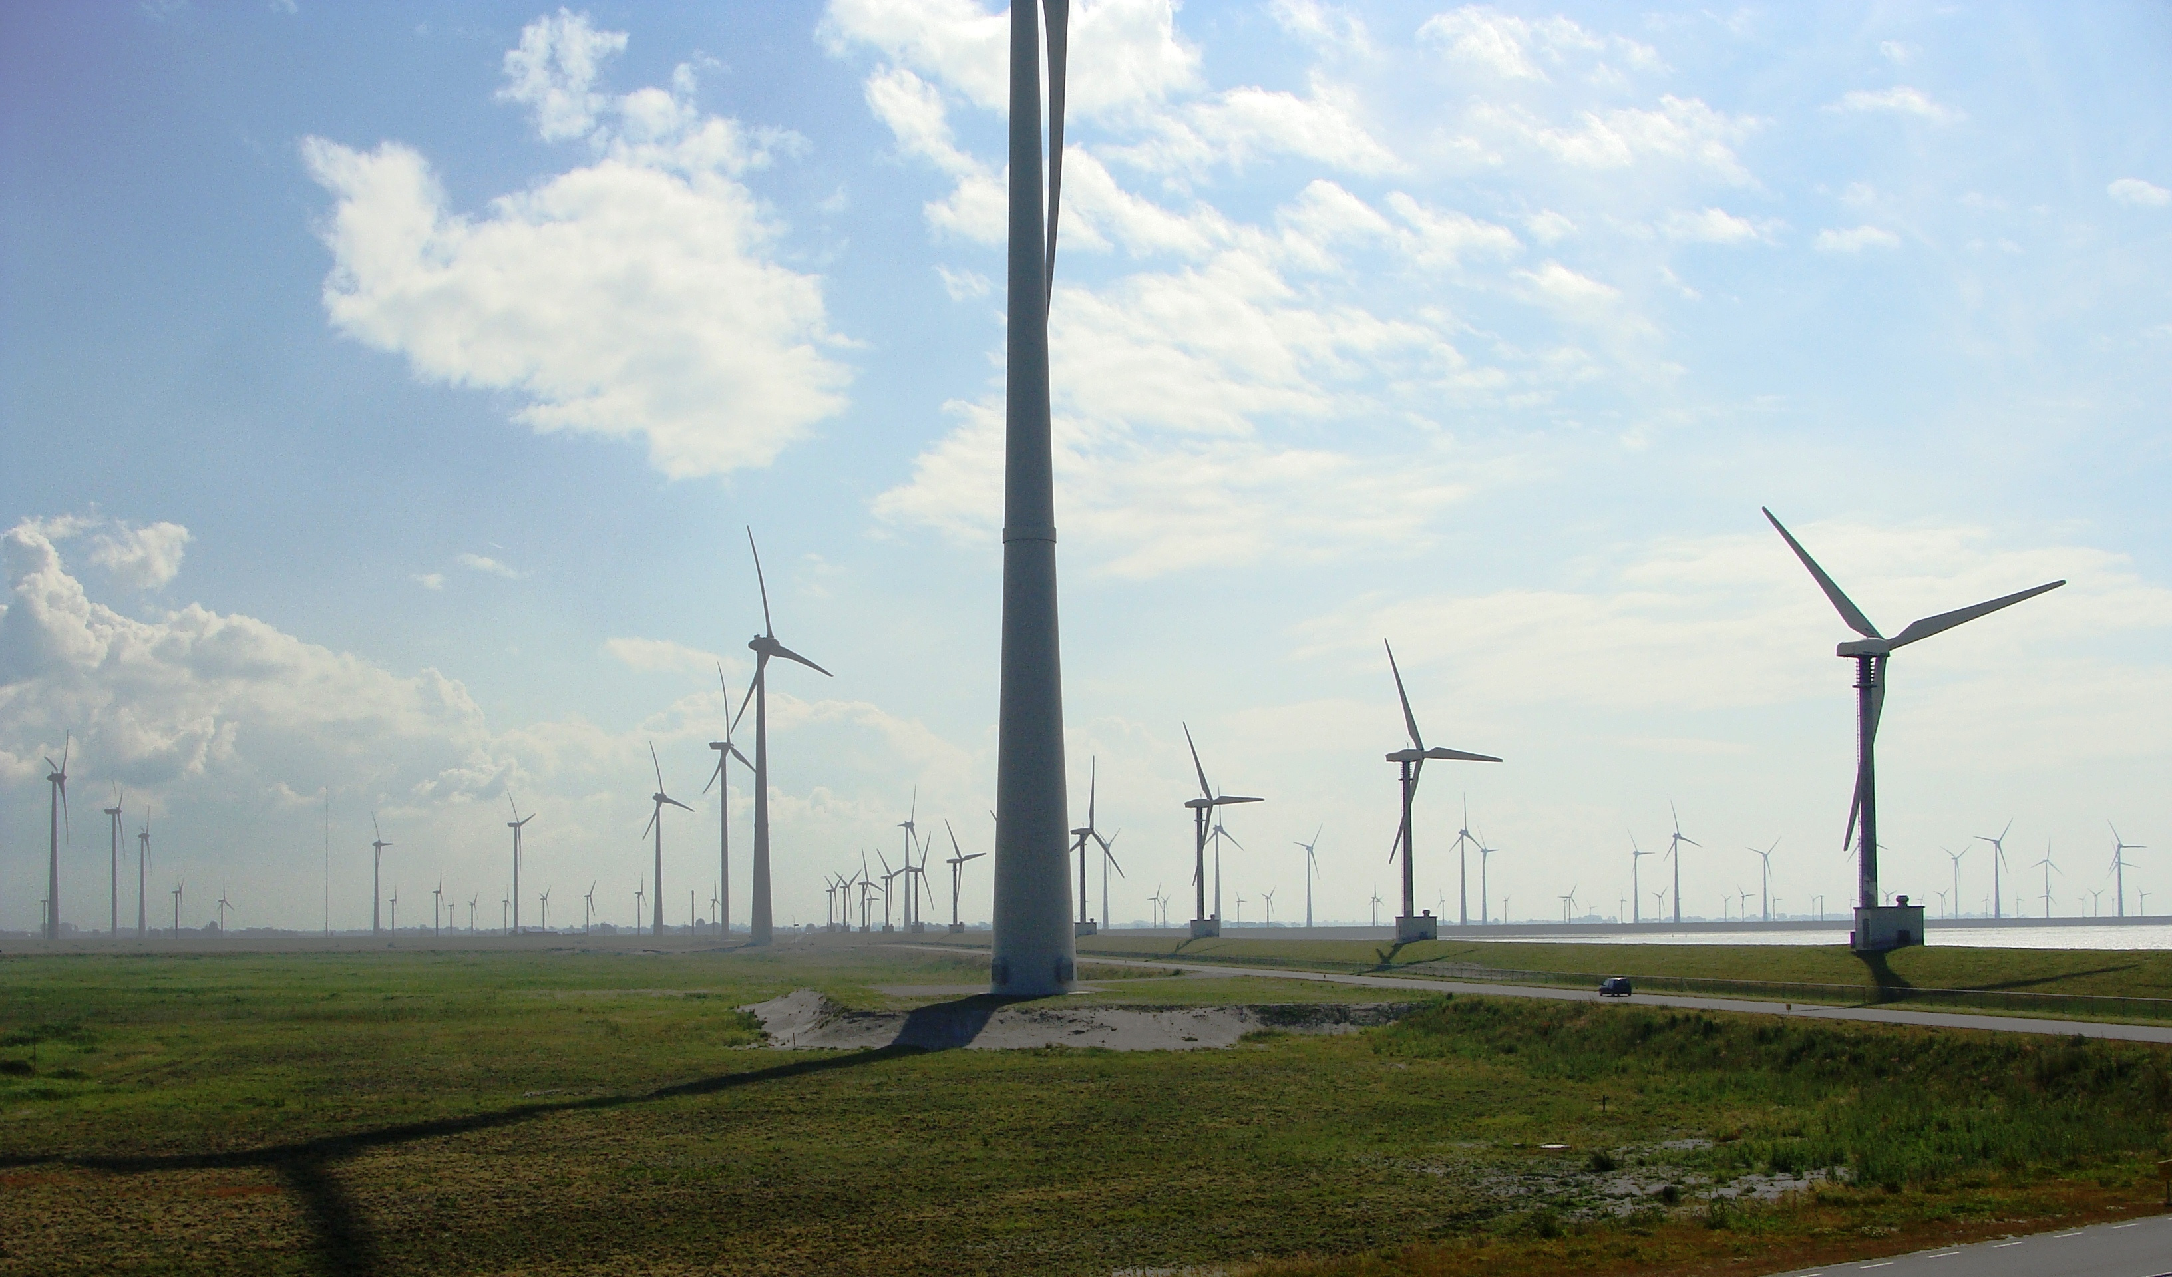


DAFT-AUG 2021:Ishmael Ho
Renewable Energy in Europe

Slide 2
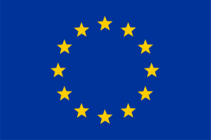
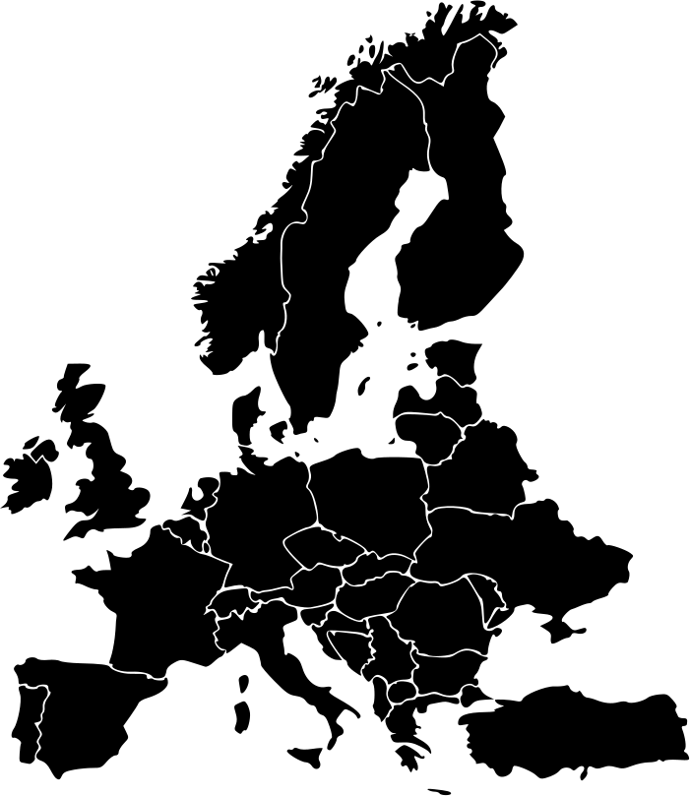
Introduction
Climate Change and the scramble to reduce CO2 Emissions is rapidly becoming one of the major challenges of the 21st century.
In 2009, the Renewable Energy Directive set out a plan to achieve 20% of total energy needs with renewables by 2020.
In 2018, the target was raised to 34% by 2040.
Just this year the target has been adjusted once more to a total of 40% by 2040
04

Slide 3


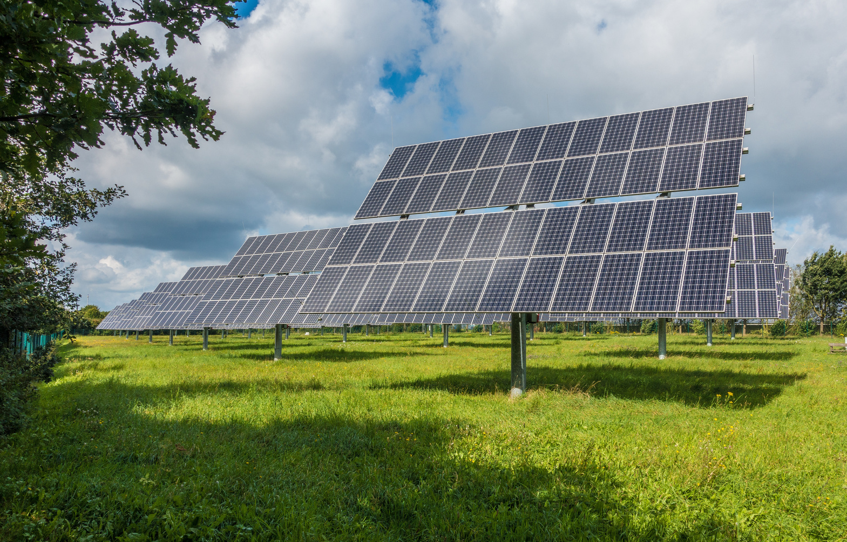
In a nutshell...
ENERGY IS LIFE!

Slide 4
Looking at the E.U
Even with each member state of the EU working towards a renewable energy goal there are some clear leaders in renewable energy development...
27
COUNTRIES
4 million
km²

Slide 5
Renewable Energy Use by EU member
1,250,299
Kilotonnes of Oil Equivalent of Energy
36%
from Oil and Petroleum products
10%
Renewables and Biofuels *
*Excluding non-renewable waste and biomass energy.

Slide 6
Sweden
Leaders in Renewable Energy?
Finland
Norway
Iceland
Montenegro

Slide 7
Germany
Leaders in Renewable Energy?
France
Sweden
Italy
Spain

Slide 8
Fastest Growth in the Sector
Norway
Denmark
Bosnia and Herzegovina
Kosovo
Iceland

Slide 9
Fastest Growth in the Sector
Norway
Denmark
Bosnia and Herzegovina
Kosovo
Iceland

Slide 10
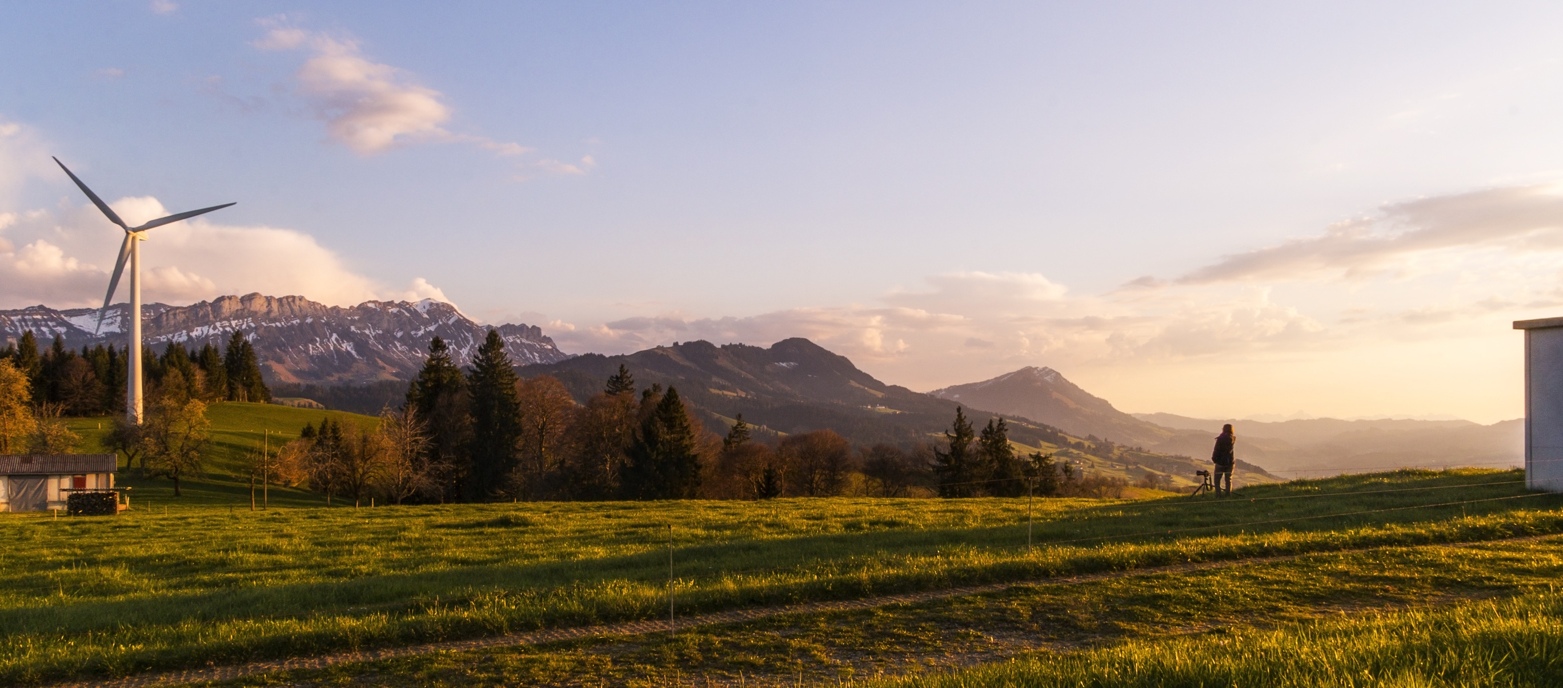
How can we improve this?

Slide 11



THE THREE MOST PROMISING SOURCES OF RENEWABLE ENERGY AT THE MOMENT ARE...
1
2
3

Slide 12
For now, let's look at Solar and Wind Energy!
1
2

Slide 13

Solar Energy in the EU
The first thing to note is that solar panels don't just magically absorb sunlight and turn it into electricity.
At least 4 hours of peak solar irradiation are necessary for profitable generation of energy by efficient solar panels.

Slide 14
Solar Energy in the EU
So, let's say you wanted to start a solar farm of your own,
where is the best place to put solar panels in the EU?

Slide 15
Solar Energy in the EU
With a chloropleth map we can see the countries with the highest average solar insolation...
Cyprus
Turkey
Portugal
Spain
Greece

Slide 16
Solar Energy in the EU
We will also need a lot of open land unsettled land...
Good thing we also have this totally different chloropleth map.
Turkey
Spain

Slide 17
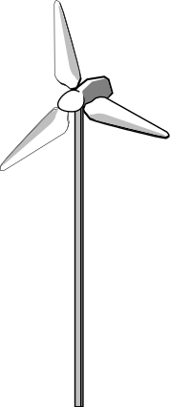
Wind Energy in the EU
Wind energy is experiencing a boom at the moment due to improvements in wind turbine manufacturing and design,
but also thanks to GIS and weather data forecasting
(*cough* Thanks, Big Data *cough*).

Slide 18
Wind Energy in the EU
Like Solar Energy however, WHERE wind turbines are placed is of critical importance.
An average windspeed of 5 m/s is just enough to get a modest sized wind turbine started, but the optimal range is significantly higher.

Slide 19
Wind Energy in the EU
Which countries seem to have an advantage for setting up onshore windfarms?

Slide 20
Wind Energy in the EU
Which countries seem to have an advantage for setting up onshore windfarms?

Slide 21
Wind Energy in the EU
In fact, we can already see that some countries are capitalizing
on this.

Slide 22

Wind Energy in the EU
Finally, let's look at offshore wind energy the brave new frontier of renewables!
Onshore windfarms have a few caveats:
they need to be in an optimal wind region to be profitable
they can be loud
they are a hazard to birds
...and some people just don't like wind turbines

Slide 23
Wind Energy in the EU
The solution? Put them in the ocean!
Ocean winds are strong and more consistent than onshore winds making them a good choice for stable and continuous energy production.

Slide 24
Wind Energy in the EU
They also have the capacity to produce large amounts of energy.

Slide 25
Wind Energy in the EU
Where can offshore windfarms be leveraged to improve renewable energy production?

Slide 26
Wind Energy in the EU
Where can offshore windfarms be leveraged to improve renewable energy production?

Slide 27
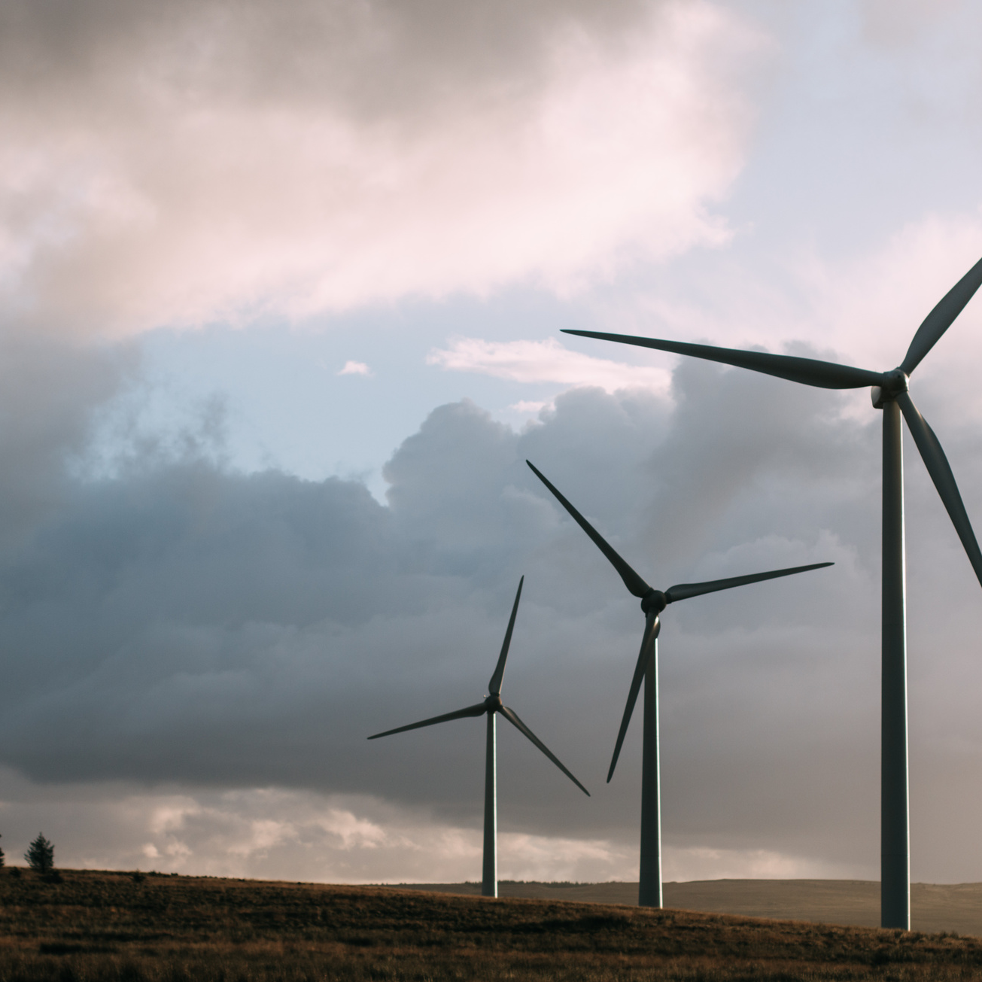
Data Sourced from:
https://ec.europa.eu/eurostat/data/database?node_code=nrg_bal_c
https://data.worldbank.org/indicator/SP.POP.TOTL?end=2020&locations=EU&start=2020&view=map
https://cds.climate.copernicus.eu/cdsapp#!/dataset/sis-energy-derived-reanalysis?tab=form
https://globalwindatlas.info/
https://www.emodnet-humanactivities.eu/search-results.php?dataname=Wind+Farms+(Points)
https://globalwindatlas.info/

Slide 28
The End
Thank you for coming to my TED talk.

